Slide 1
CH – 12
THREE DIMENSIONAL GEOMETRY
CONTENT:
Straight Line in space and Equation
Angle Between Two lines
Shortest Distance between skew Lines
Co-planarity of Two Lines

Slide 2
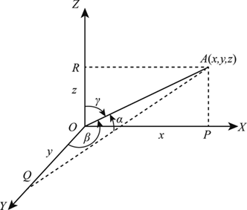
Direction Cosines and Direction Ratios
i) Direction Angles: As we have studied in two dimensional geometry each line is having slope in terms of tangent of the angle made by the line with positive direction of X axis. Similarly in three dimensional geometry if a directed line is passing through origin makes angles α, β and γ with positive directions of X, Y and Z axes respectively then the angles are known as direction angles. (angels are shown in adjacent figure)
Notes:
Asmd

Slide 3
ii) The cosine of these directed angles, cosα, cosβ, and cosγ are termed as direction cosines of the line with general notation l, m and n respectively. These can be obtained using above figure as follows-
Note-1: If the direction of the line is reversed then direction
angles will be replaced by π - α, π - β and π - γ i.e. the signs of
direction cosines are reversed.

Slide 4
Note-4: The dr’s of a line segment with end points at P(x₁, y₁, z₁) and Q(x₂, y₂, z₂) are x₂ – x₁, y₂ – y₁, z₂ – z₁ or x₁ – x₂, y₁ – y₂, z₁ – z₂ after getting dr’s of line segment as a, b, c we can find dc’s l, m, n.
Example-1: If a line make 90º,135 º,45 º with the x, y ,and z axes
respectively find it direction cosines.
Solution: The dc’s can be obtained as
⇒l = cos90°=0, m = cos135°= , n = cos45°=
Example-2: If dr’s of a line are 6, 2, 3 then find its dc’s.
Solution: a = 6, b = 2, c = 3 then

Slide 5
Example-3: Find the direction cosines of the line joining of the points (7, -5, 9) & (5, -3, 8).
Solution: The dr’s of line joining of A(7, -5, 9) & B(5, -3, 8) are
⇒ 5 – 7, – 3 + 5, 8 – 9 i.e. –2, 2, –1
Now dc’s of line joining of A & B can be obtained as
Example-4: Show that the points (1, –2, 3), (2, 3, –4), (0, –7, 10) are collinear.
Solution: The similar problem had been solved by us in class XI using section formula as well as in Vector Algebra. Now we will see how to show using dr’s & dc’s. The points A (1, –2, 3), B(2, 3, –4), C(0, –7, 10) will be collinear if dr’s of AB will be proportional to the dr’s of BC. dr’s of AB⇒ 1, 5, – 7 and dr’s of BC ⇒ – 2, – 10, 14
Since therefore A, B & C are collinear.

Slide 6
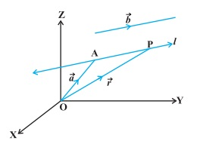
Equation of line in space
Equation of a line passes
through a point and parallel to
given vector:

Slide 8
Note- 2: If the line is not passing through origin then a line passes through origin can be drawn which is parallel to the given line then the direction cosines of both the lines will be proportional.
Note- 3: Three numbers which are proportional to the direction cosines of a line are said to be direction ratios of the line. If l, m and n are dc’s of a line then its dr’s will be as a =λl, b = λm and c
= λn where λ∈ R-{0}.

Slide 9
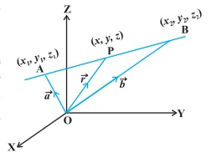
2. Equation of a line passes
Through two given points:

Slide 11
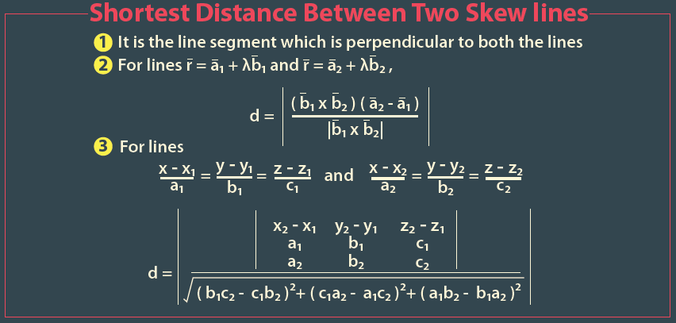


Slide 12
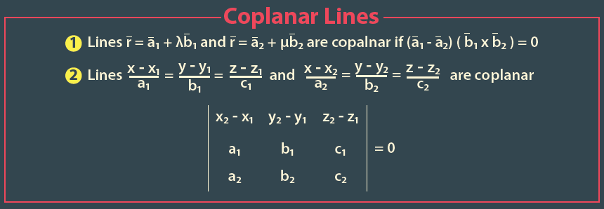
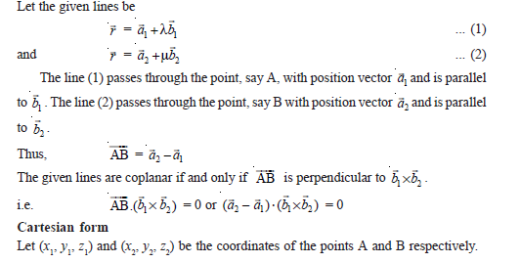

Slide 13
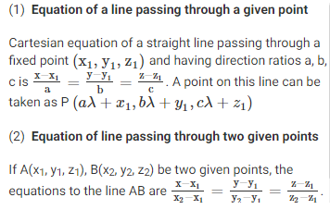

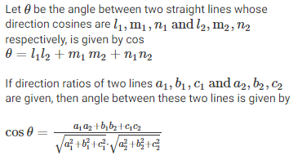
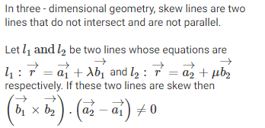




IMPORTANT NOTE
Shortest distance b/w two skew lines
Lines are not co-planer
Distance between parallel lines

Slide 14
Planes
Although a line in space is determined by a point and a direction, a plane in space is more difficult to describe.
A single vector parallel to a plane is not enough to convey the “direction” of the plane, but a vector perpendicular to the plane does completely specify its direction.
Thus a plane in space is determined by a point P₀(x₀, y₀, z₀) in the plane and a vector n that is orthogonal to the plane.
This orthogonal vector n is called a normal vector.

Slide 15
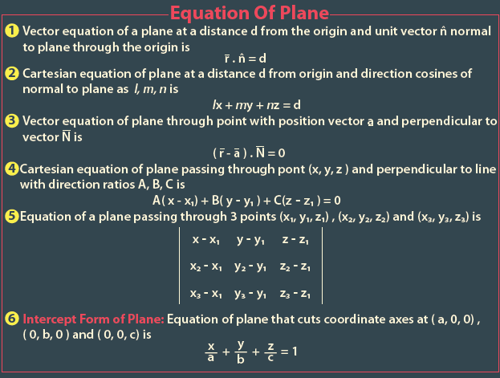

Slide 16
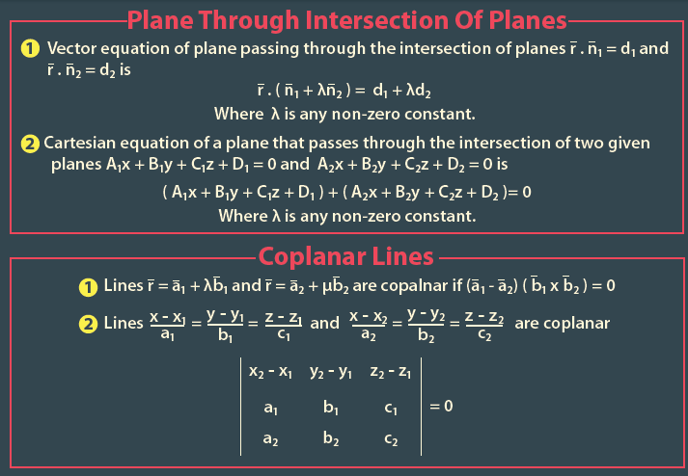

Slide 17
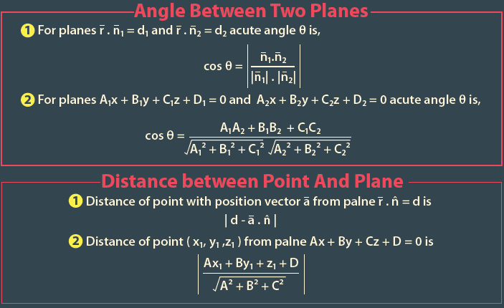

Slide 18
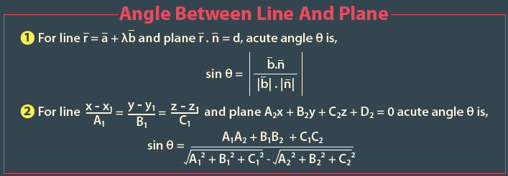
THANK YOU

